Slide 2
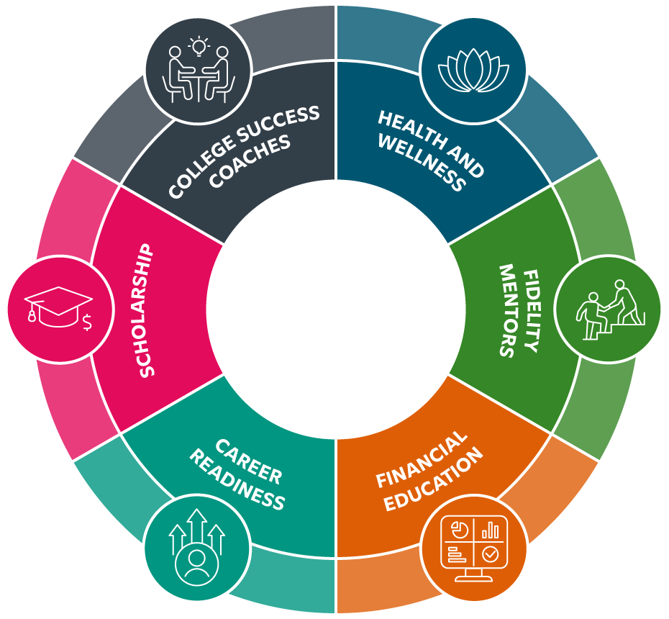
Helping Students Reach Their Potential
Fidelity Scholars Program
Resources and Support
Notes:
We believe in your potential and are committed to providing the resources and support you need to excel in college and beyond. Empowering your journey to success, here’s what sets the Fidelity Scholars Program apart:
Financial Assistance: Financial support is only the beginning. By easing the financial burden, we enable students to focus more on their studies and less on how they’ll pay for them.
College Success Coaches: Access to dedicated college success coaches who are committed to guiding students through every step of your academic journey. From navigating the college campus to succeeding in your coursework, coaches provide personalized support and guidance.
Mental Health Support: College can be overwhelming, especially for first-generation students who may not have a family history of higher education to draw upon. That’s why we have intentionally included access to mental health resources through our partnership with the Steve Fund. We recognize that mental well-being is essential to academic success.
Mentorship: Mentorship is a cornerstone of this program. We have nearly 500 Fidelity associates who volunteer their time as mentors to our scholars – helping students build confidence, develop their talents, and overcome challenges and we provide the mentor coaching and resources to our associates with our partner, MENTOR.
Financial Education: We equip students with the knowledge to make informed decisions about budgeting, saving and managing debt. These skills are crucial not only for their time in college but for their long-term financial well-being.
Career Readiness:

Slide 3
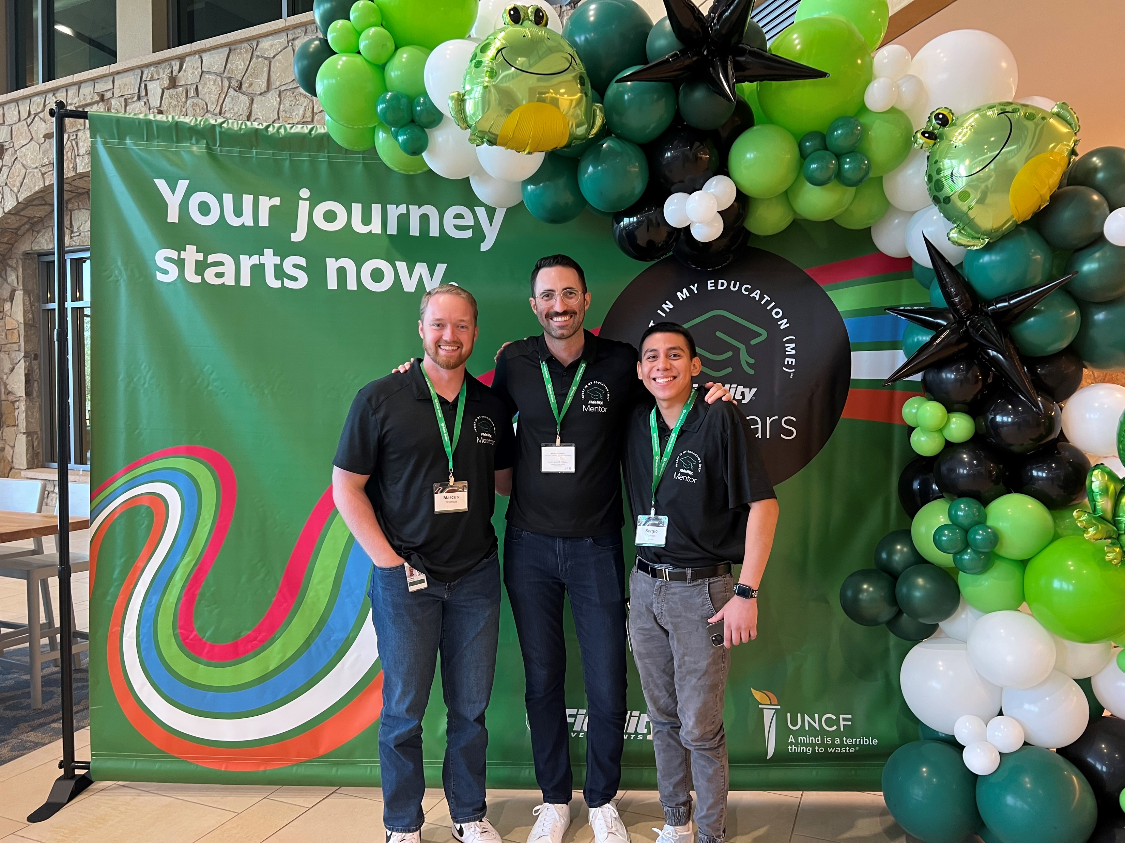
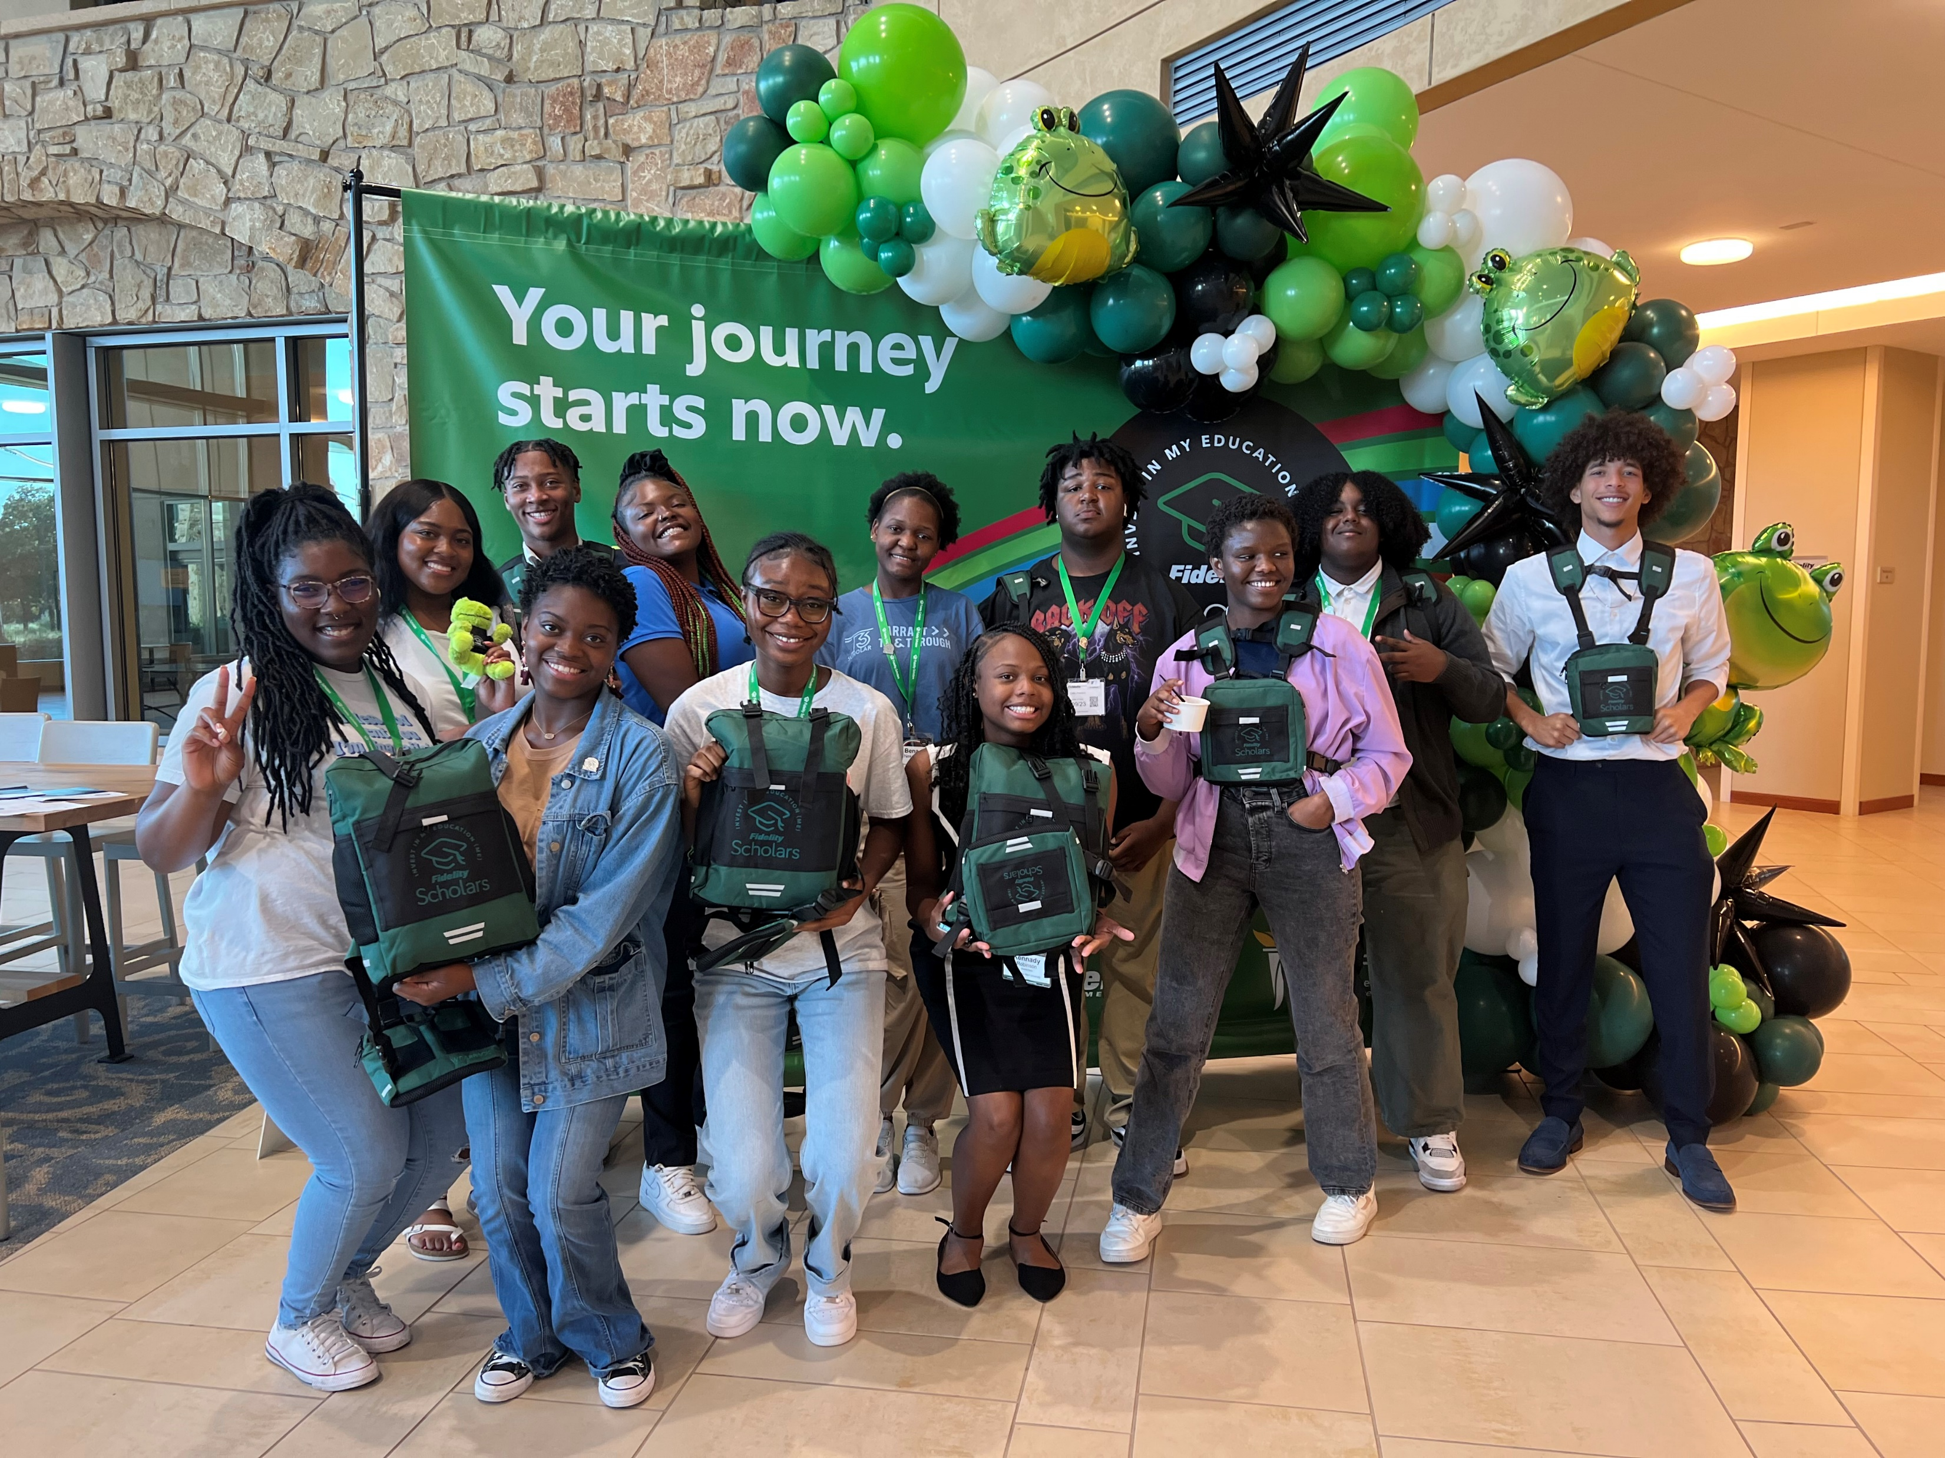
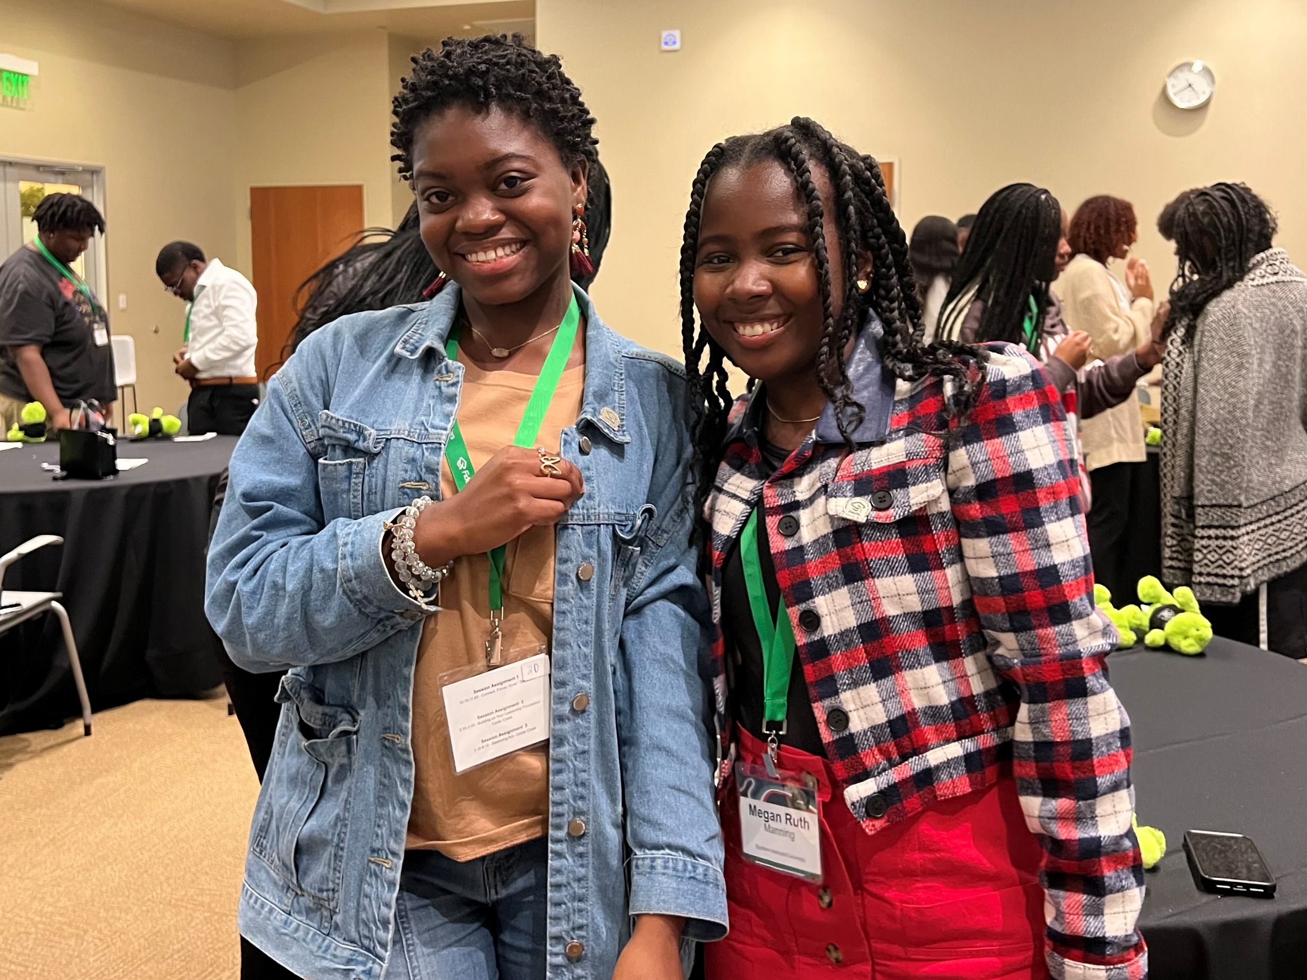
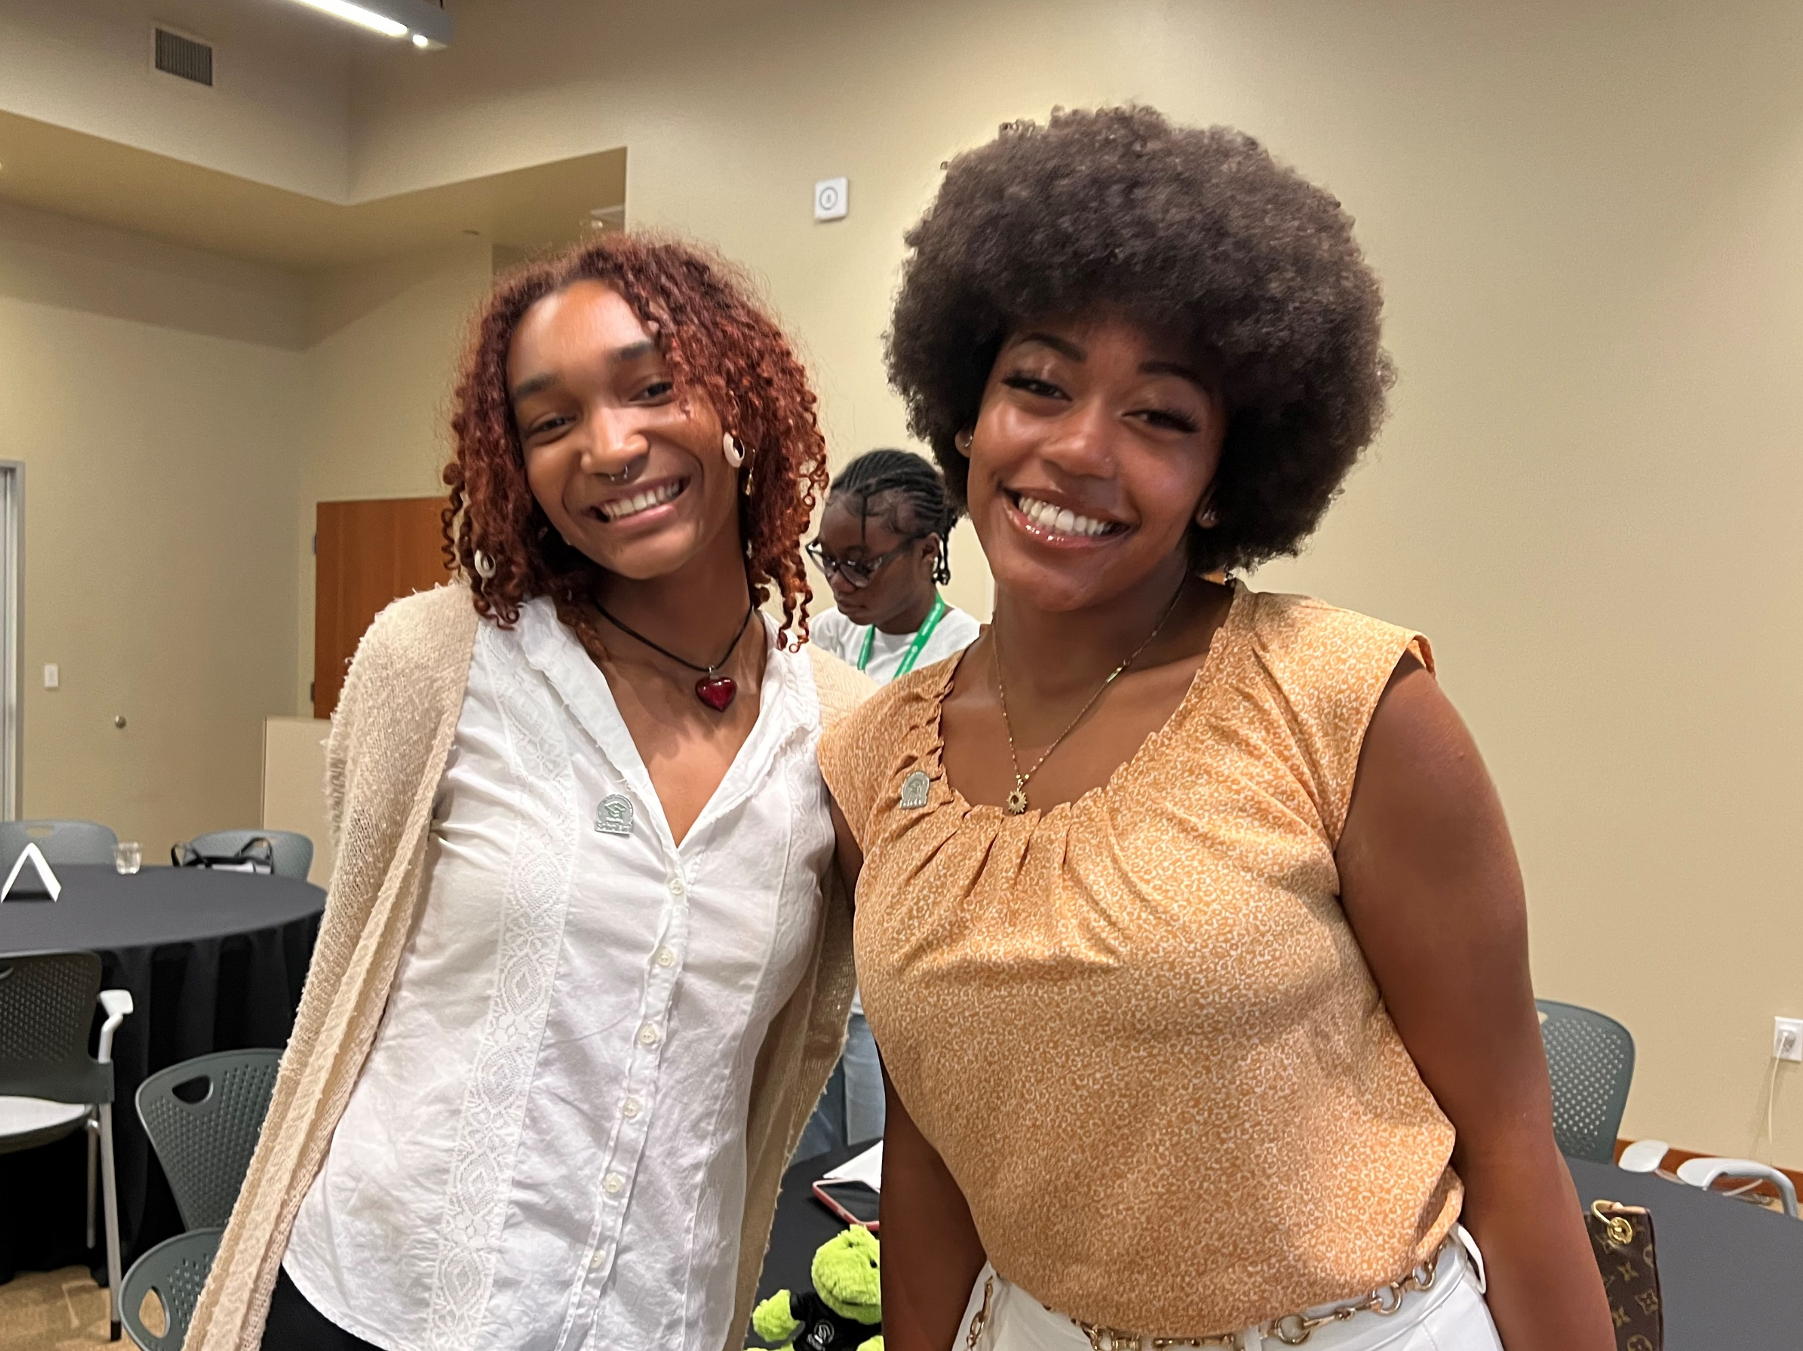
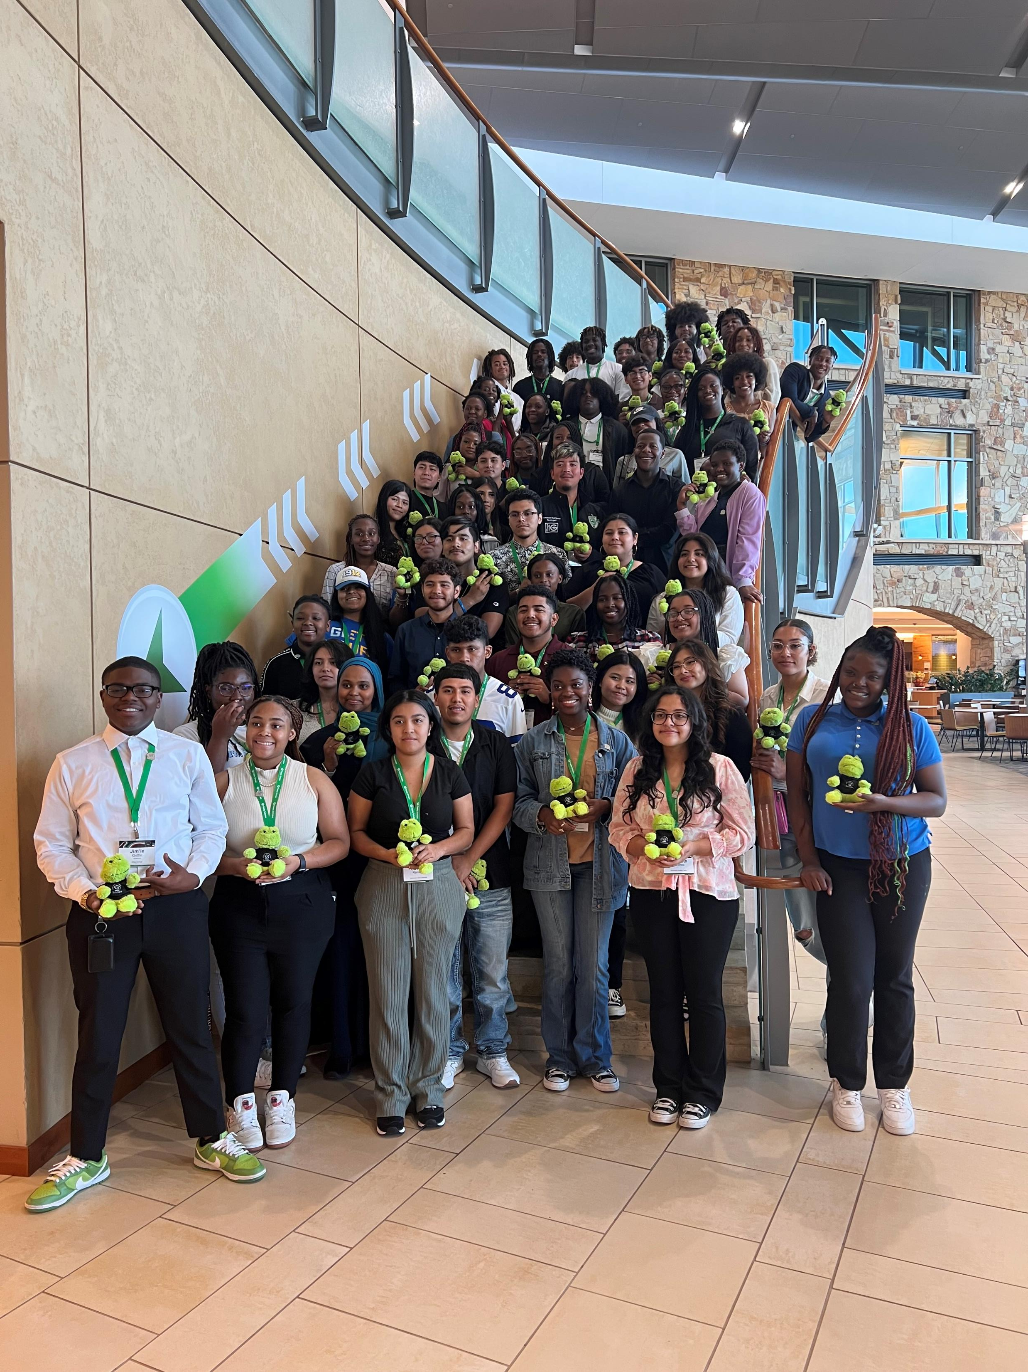
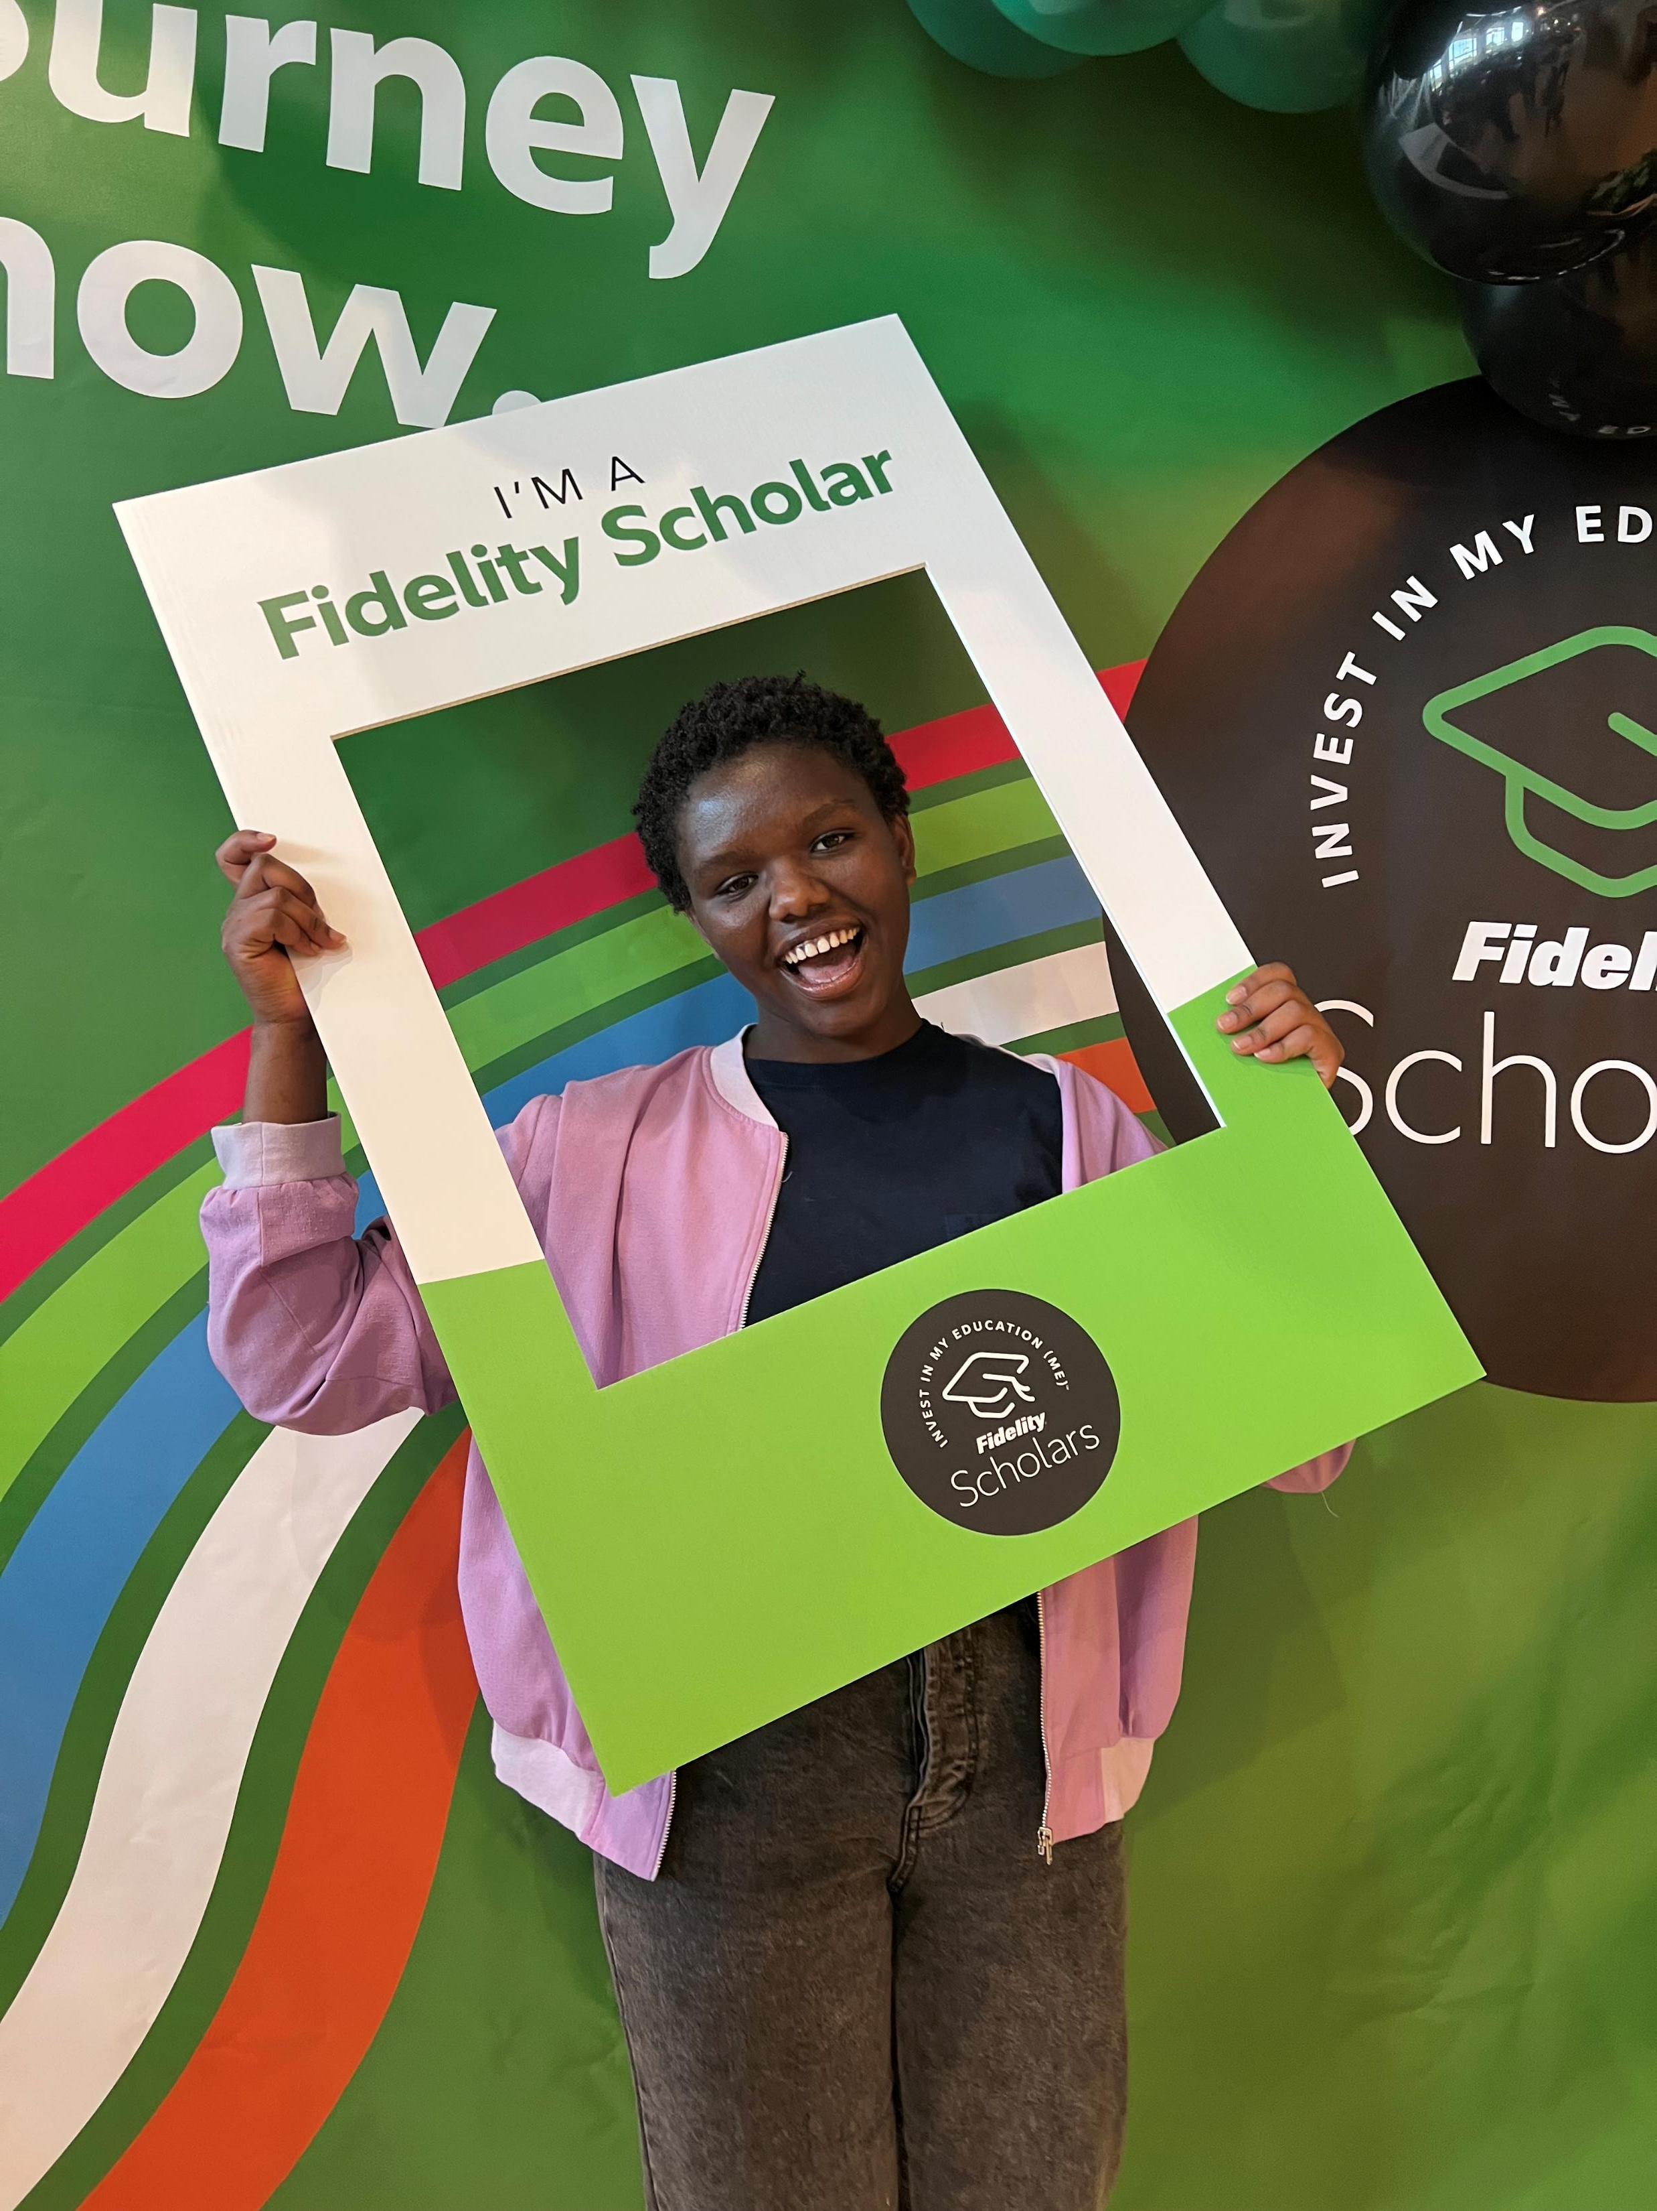
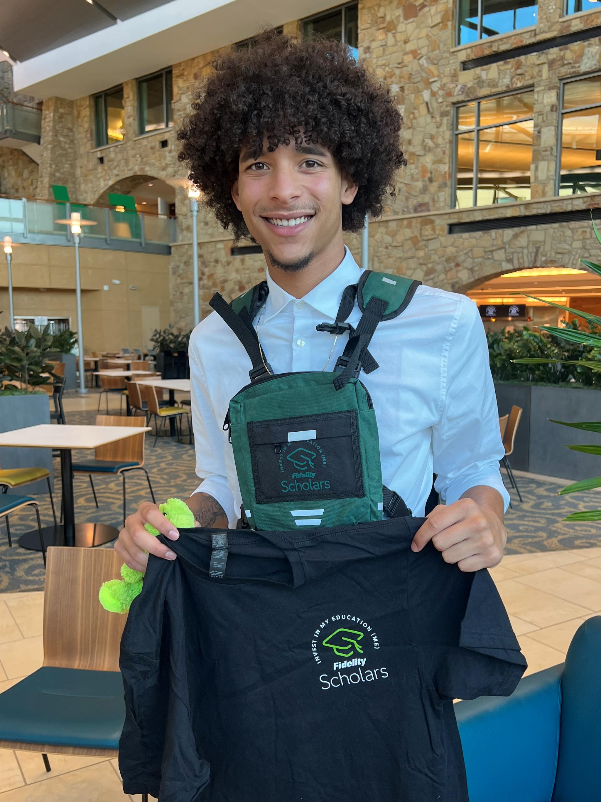
$12 MILLION
Notes:
Since 2023, the Fidelity Scholars Program has awarded more than 750 Scholars more than $12 million in scholarships. This fall, 650 new scholars joined the program, bringing the total number of Fidelity scholars to over 1,200.

Slide 4
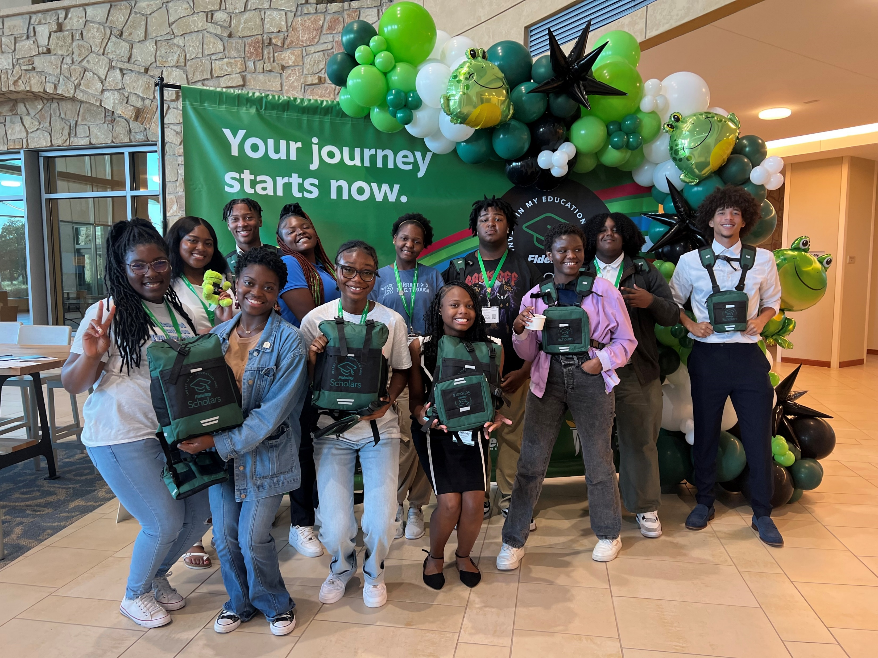
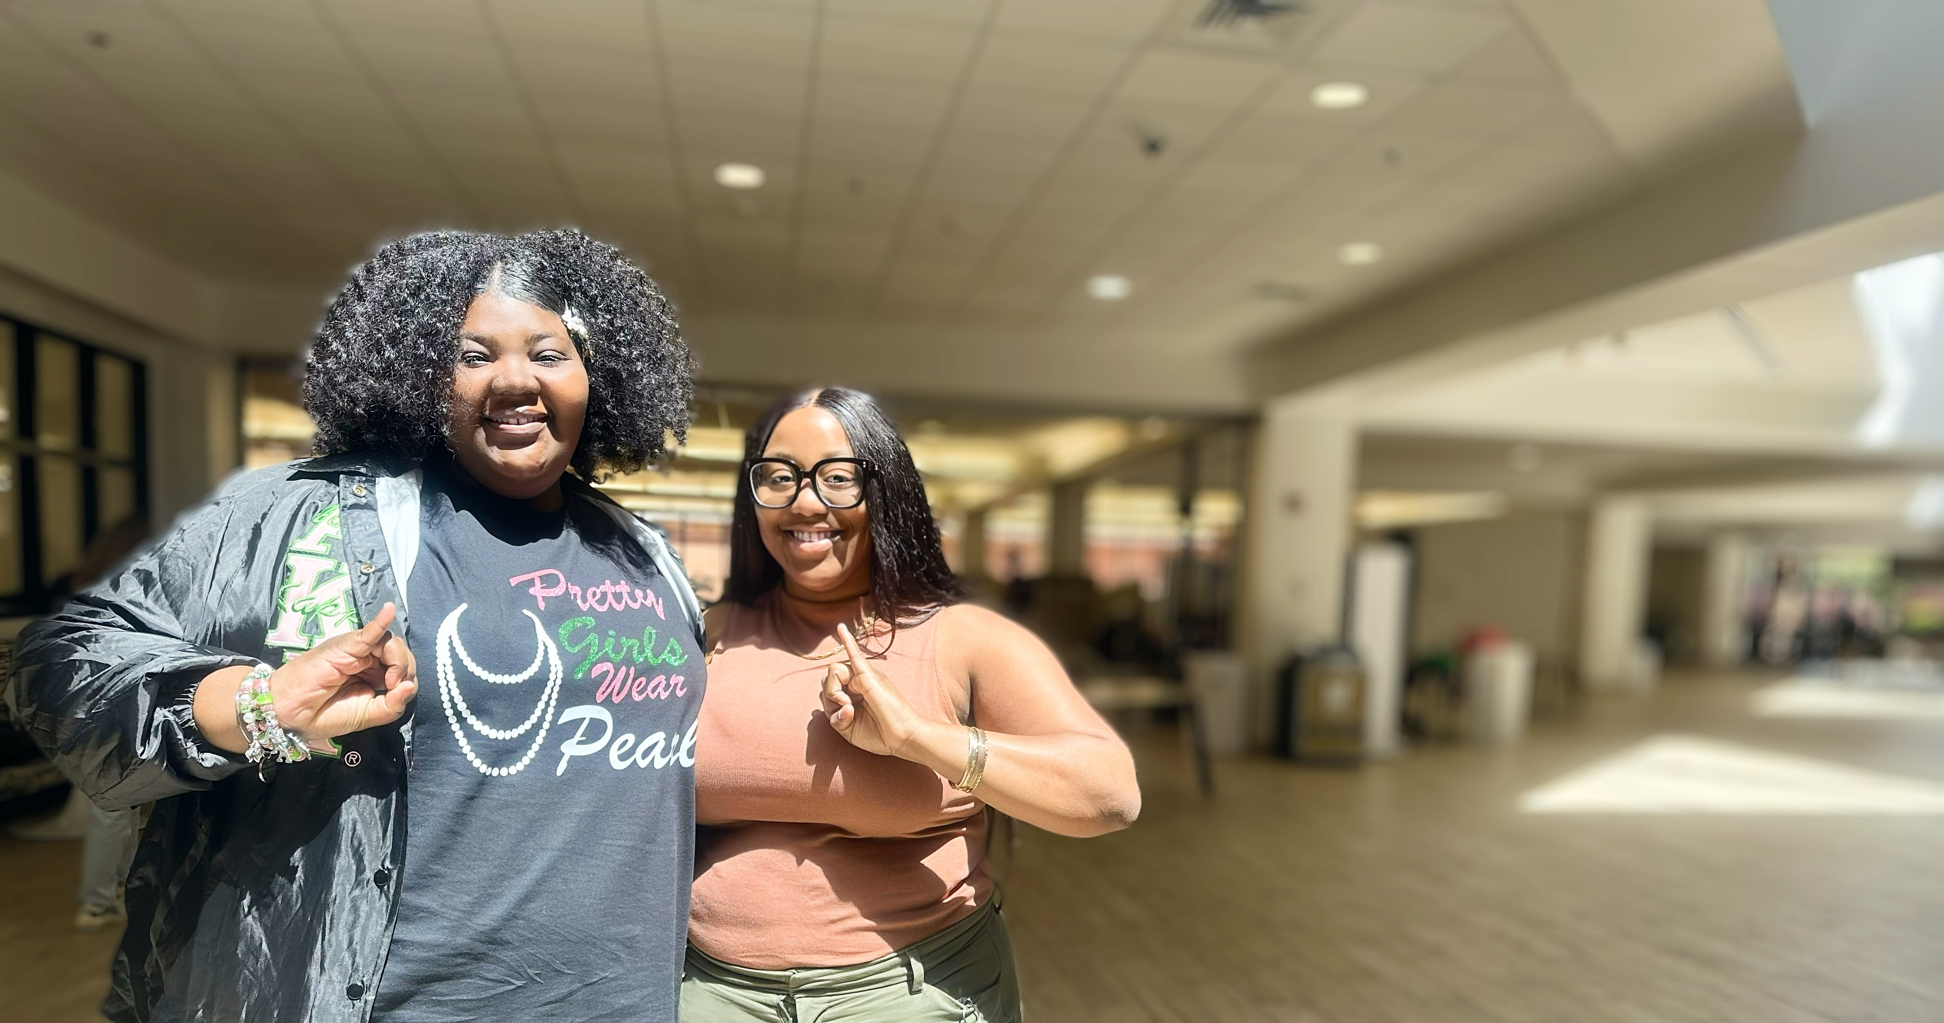
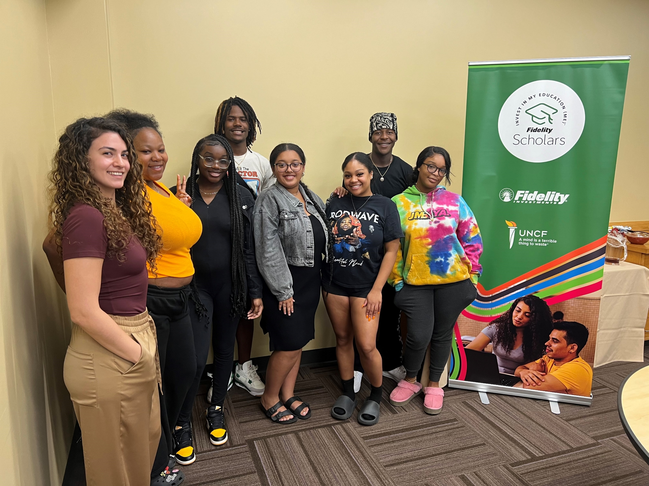
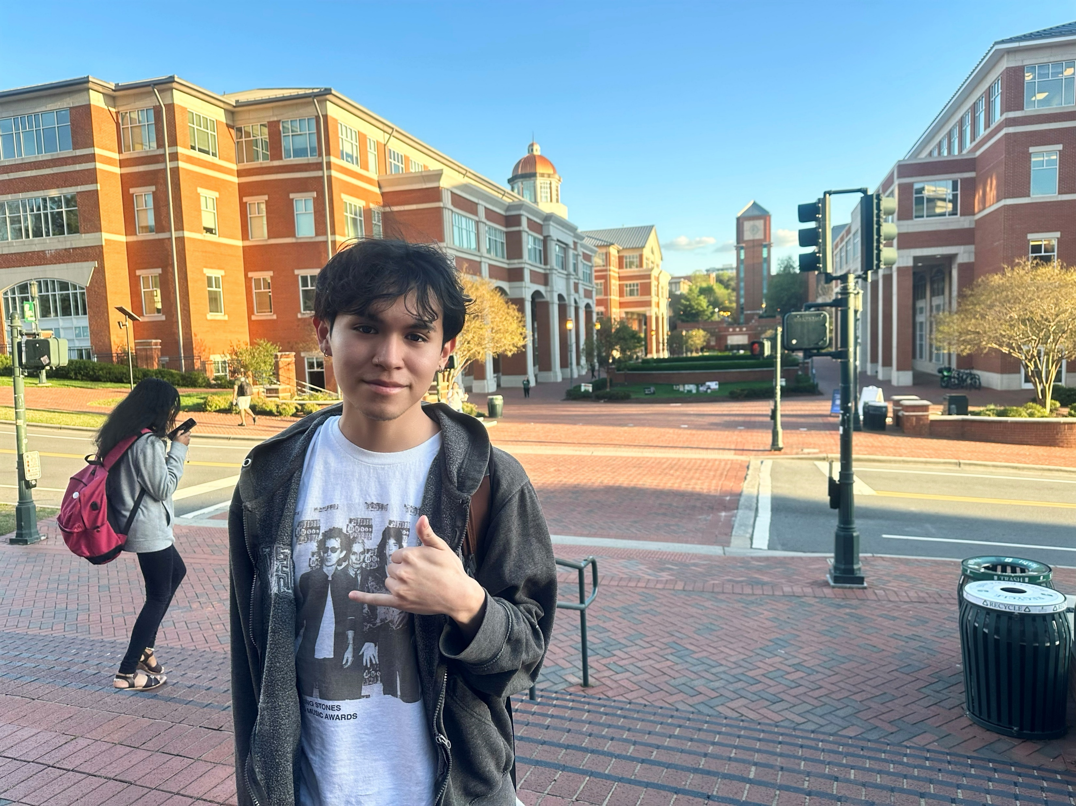






Engaging Support for our Scholars
Know Before You Go and Orientation
Meet with College Success Coach and Mentors
Campus Events and Webinars, Financial
Education
Career Readiness Workshops
Key Partners

Slide 5






How does the scholarship work?
The Fidelity Scholars Program is a renewable scholarship. It is designed to reduce the overall cost of attendance, making college more accessible and affordable.
Cost of attendance is a college's total estimated expenses for one year, including:
Tuition and Fees
Books
You can afford to go to college!
Housing
Transportations
Meals
Other educational costs such as supplies and equipment
Notes:
This slide is animated

Slide 6


Opportunity for YOU
Application for the 2026-2027 award year opens October 1, 2025
ELIGIBILITY REQUIREMENTS
1
2
3
4
2.5 - 3.59
unweighted GPA
or GED certificate
Pell eligible and/or demonstrate financial need
Aged 16-24 in participating regions:
CO, FL, KY, MA, NJ, NH, NM, NC, OH, RI, TX, UT, Washington D.C.
Attend as an incoming 2026-27 freshman to a public or private college or university in the state that you reside

Slide 7



Fidelity Scholars Application Process
Oct 1
Jan 29
March
April
Application Opens
Application Closes
All finalists will be notified by email.
You will be asked to submit your admission letter and financial aid letter for verification.
Award day!
Fidelity Scholars
notified by email
Steps to apply:
Create your profile on the UNCF website
Complete the Application for the Fidelity Scholars Program
Activities, experiences
Essay
Vision Board
Recommendation
Transcript
Complete the FAFSA

Slide 8

Prepare now
Important Dates
Register on Opportunities.UNCF.org
We’ll send you an email in the fall when the application opens. Create your profile. Save your user ID / password!
Start your research
Check out schools online, talk with others, or visit them if you can
  Make sure to include in-state schools aligned with your interests/goals.
  What type of environment do you thrive in?
  Write down those application deadlines
Talk with your family
Share your aspirations and have the money talk.
  Begin to create a financial plan and potential budget
  Plan to complete the FAFSA: grants, scholarships
  Write down those FAFSA and scholarship deadlines
Application preparation
Get a head start
  Create a resume or accomplishments list
  Request letters of recommendation; ask early and provide key details
  Prepare responses to questions / personal statement
October 1
Fidelity Scholars Program Application Opens
The application closes on January 29, 2026. You will be required to complete an essay, submit your transcript and upload a letter of reference.
October 1
FAFSA opens
Create your FSA-ID and have your parent/guardian create their FSA-ID ahead of that date.
January 29
Application Closes
Submit by 11:59pmET

Slide 9



Learn more
FidelityScholars@uncf.org
Application opens October 1, 2025
Closes January 29, 2026

Slide 11
DC Eligible Schools
DC Metro Area
Howard University
Georgetown University
George Washington University
American University
Catholic University
Trinity Washington University
UDC
Gallaudet University
George Mason University
Marymount University
University Of Maryland College Park
Bowie State University
Capitol Technical University
Washington Adventist
College Of Southern Maryland
UMGC
Greater Baltimore
University of Maryland Baltimore County
University of Baltimore
Towson University
Coppin State University
Morgan State University
Goucher College
John Hopkins
Notre Dame of Maryland
Loyola University
Maryland Institute College of Art
University of Maryland, Baltimore
Stevenson University
Frostburg University

Slide 12
DC Eligible Schools cont.
Tidewater/ Hampton Roads
Christopher Newport University
Norfolk State University
Hampton University
Old Dominion University
Virginia Weslyan University
Lower Eastern Shore (MD)
Salisbury University
University of Maryland Eastern Shore
Greater Richmond
University of Richmond
Virginia Commonwealth University
Virginia Union University
Virginia State University

